Slide 1

P4: specifying data planes http://P4.org
VMware Techtalk March 30, 2017
Mihai Budiu
VMware Research Group

Slide 2

About Myself
Ph.D. from Carnegie Mellon
Researcher at Microsoft Research, Silicon Valley
Distributed systems, security, compilers, cloud platforms, machine learning, visualization
Software engineer at Barefoot Networks
Design and implementation of P4
Researcher at VMware Research Group
Big data, P4

Slide 3

Presentation outline
P4 & Programmable networks
Why should you care?
An introduction to P4₁₆
P4 limitations
Conclusions

Slide 4
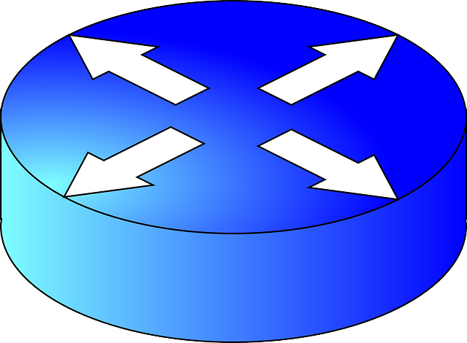

Networking 101
Data packets
routers

Slide 5
Control and Data Planes
Switch architecture
Control plane
packets
Data plane
Interfaces

Slide 6
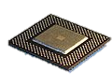
Traditional switch architecture
Control-plane CPU
Control plane
Table management
Data plane
Switch ASIC
Look-up tables (policies)

Slide 7
Software-Defined Networking
Policies/signaling
Controller
Dumb control plane
Data plane

Slide 8
The P4 world
Upload program
Policies/signaling
Dumb control plane
Programmable data plane
SW: P4

Slide 9
Not just for switches!
Programmable switches
FPGA switches
Programmable network cards
Software switches
Hypervisor switches
You name it…
Control plane
Programmable data plane
SW: P4

Slide 10


How is this possible?
Hello
?
Datacenter
Most useful if you have your own network playground

Slide 11

Data-planes
From now on in this presentation we only talk about the data-plane
We expect that SDN will continue to evolve the control-plane
Control plane
Data plane

Slide 12

WHY SHOULD YOU CARE?

Slide 13
Isn’t Open-Flow Enough?
Open-Flow version
Open-flow has never been enough: it keeps changing to describe new protocols

Slide 14


has lots at stake
NSX is about programmable networks
Flexibility in networking
We are an industry leader
P4 will change the dynamics in the industry
Device manufacturer ≠ device programmer
Many network capabilities exposed to software

Slide 15
Protocols = programs
VxLAN: 175 lines of P4
Took 4 years from proposal to wide availability
NVGRE: 183 lines of P4
M. Shahbaz, S. Choi, B. Pfaff, C. Kim, N. Feamster, N. McKeown, J. Rexford, PISCES: A Programmable, Protocol-Independent Software Switch SIGCOMM 2016
40 times reduction in the size of the OvS parser
Much easier to add new protocols
Same performance

Slide 16

Use only what you need
IETF has issued thousands of RFCs
Switch RAM and CPU is very expensive
Network operators can remove protocols
Simpler troubleshooting

Slide 17

Network monitoring
measurements
(custom headers)
Monitoring
agent
In-Band Network Telemetry (INT)
Improving Network Monitoring and Management with Programmable Data Planes
By Mukesh Hira & LJ Wobker

Slide 18

Optimize your network
Push application functionality in the network
High speed
Paxos Made Switch-y
Huynh Tu Dang, Marco Canini, Fernando Pedone, Robert Soulé
CCR April 2016

Slide 19


Network = software
Use software engineering principles and tools
Upgrade your network at any time
Protocols = intellectual property

Slide 20



P4.org Consortium
Carriers, cloud operators, chip co.s, networking, systems, universities,
start-ups

Slide 21

AN INTRODUCTION to P4₁₆

Slide 22

Language evolution
P4: Programming Protocol-Independent Packet Processors
Pat Bosshart, Dan Daly, Glen Gibb, Martin Izzard, Nick McKeown, Jennifer Rexford, Cole Schlesinger, Dan Talayco, Amin Vahdat, George Varghese, David Walker ACM SIGCOMM Computer Communications Review (CCR). Volume 44, Issue #3 (July 2014)
P4 v1.0 spec, reference implementation and tools released in Spring 2015 (mostly by Barefoot Networks), Apache 2 license, http://github.com/p4lang.
P4₁₆ spec, reference implementation and tools released in December 2016.

Slide 23

P4 Community
http://github.com/p4lang
http://p4.org
Mailing lists
Workshops
P4 developer days
Academic papers (SIGCOMM, SOSR)

Slide 24

Available Software Tools
Compilers for various back-ends
Netronome chip, Barefoot chip, eBPF, Xilinx FPGA
(open-source and proprietary)
Multiple control-plane implementations
SAI, OpenFlow
Simulators
Testing tools
Sample P4 programs
Tutorials

Slide 25
P4₁₆
Most recent revision of P4
Similar to C; strongly typed
Currently in draft form
Spec: http://p4.org/wp-content/uploads/2016/12/P4_16-prerelease-Dec_16.pdf
Reference compiler implementation (Apache 2 license): http://github.com/p4lang/p4c

Slide 26
P4₁₆ data plane model
Programmable blocks
Data plane
P4
P4
P4
Fixed function

Slide 27
Example packet processing pipeline
Programmable
parser
eth
vlan
ipv4
Headers
Payload
Packet (byte[])
Programmable
match-action
units
eth
ipv4
port
Queueing/
switching
mtag
err
bcast
Metadata
Headers
eth
mtag
ipv4
Programmable
reassembly
Packet

Slide 28
Language elements
Programmable
parser
State-machine; bitfield extraction
Programmable
match-action
units
Table lookup; bitfield manipulation; control flow
Programmable
reassembly
Bitfield reassembly
Data-types
Bitstrings, headers, structures, arrays
user
Target
description
target
Interfaces of programmable blocks
External libraries
Support for custom accelerators

Slide 29
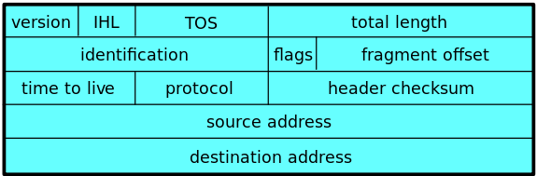
Data Types
typedef bit<32> IPv4Address;
header IPv4_h { bit<4> version; bit<4> ihl; bit<8> tos; bit<16> totalLen; bit<16> identification; bit<3> flags; bit<13> fragOffset; bit<8> ttl; bit<8> protocol; bit<16> hdrChecksum; IPv4Address srcAddr; IPv4Address dstAddr; }
// List of all recognized headers struct Parsed_packet { Ethernet_h ethernet; IPv4_h ip; }
header = struct + valid bit
Other types: array of headers,
error, boolean, enum

Slide 30
Parsing = State machines
dst
src
type
IP header
IP payload
ethernet header
parser Parser(packet_in b, out Parsed_packet p) { state start { b.extract(p.ethernet); transition select(p.ethernet.type) { 0x0800: parse_ipv4; default: reject; } }
state parse_ipv4 { b.extract(p.ip); transition accept; } }
start
parse_ipv4
accept
reject

Slide 31
Actions
~ Objects with a single method.
Straight-line code.
Reside in tables; invoked automatically on table match.
Action data; from control plane
action Set_nhop(IPv4Address ipv4_dest, PortId port) { nextHop = ipv4_dest; outCtrl.outputPort = port; }
class Set_nhop {
IPv4Address ipv4_dest;
PortId port;
void run() {
nextHop = ipv4_dest; outCtrl.outputPort = port
}
}
Java/C++ equivalent code.

Slide 32
Tables
HashMap<K, Action>
table ipv4_match() { key = { headers.ip.dstAddr: exact; } actions = { Drop_action; Set_nhop; } default_action = Drop_action; }
dstAddr | action
0.0.0.0 | drop
10.0.0.1 | Set_nhop(10.4.3.4, 4)
224.0.0.2 | drop
192.168.1.100 | drop
10.0.1.10 | Set_nhop(10.4.2.1, 6)
Populated by the control plane

Slide 33
Match-Action Processing
Control plane
action code
key
action
Execute
action data
Code & data
Lookup
headers &
metadata
Action
headers &
metadata
Lookup key
Lookup table

Slide 34
Control-Flow
Ipv4_match
control Pipe(inout Parsed_packet headers, in InControl inCtrl,// input port out OutControl outCtrl) { // output port IPv4Address nextHop; // local variable
action Drop_action() { … }
action Set_nhop(…) { … }
table ipv4_match() { … }
…
apply { // body of the pipeline ipv4_match.apply(); if (outCtrl.outputPort == DROP_PORT) return;
dmac.apply(nextHop); if (outCtrl.outputPort == DROP_PORT) return;
smac.apply(); } }
dmac
smac

Slide 35
Packet Reassembly
Convert headers back into a byte stream.
Only valid headers are emitted.
control Deparser(in Parsed_packet p, packet_out b) { apply { b.emit(p.ethernet); b.emit(p.ip); } }

Slide 36
P4 Program structure
#include <core.p4> // core library #include <target.p4> // target description
#include "library.p4" // library functions
#include "user.p4" // user program

Slide 37
Architecture declaration
Provided by the target manufacturer
struct input_metadata { bit<12> inputPort; }
struct output_metadata { bit<12> outputPort; }
parser Parser<H>(packet_in b, out H headers);
control Pipeline<H>(inout H headers, in input_metadata input, out output_metadata output);
control Deparser<H>(in H headers, packet_out p);
package Switch<H>(Parser<H> p, Pipeline<H> p, Deparser<H> d);
H = user-specified header type
Switch
Parser
Pipeline
Deparser

Slide 38
Support for custom “accelerators”
extern bit<32> random();
extern Checksum16 { void clear(); // prepare unit for computation void update<T>(in T data); // add data to checksum void remove<T>(in T data); // remove data from checksum bit<16> get(); // get the checksum for data added }
External function
External object with methods. Methods can be invoked like functions.
Some external objects can be accessed from the control-plane.

Slide 39

Execution model
When a block is invoked (parser, control) it executes to completion on a separate thread
All local variables are thread-local
Only inter-thread communication possible through extern objects and functions
Execution triggered by outside event (e.g., packet arrival)
Actions execute atomically
@atomic annotation for futher user-level control

Slide 40
P4 software workflow
User-supplied
Control-plane
P4 program
P4 compiler
API
LOAD
API
control
signals
P4 architecture
model
Dataplane runtime
Data plane
LOAD
Tables
extern objects
target
Manufacturer supplied

Slide 41

P4 LIMITATIONS

Slide 42
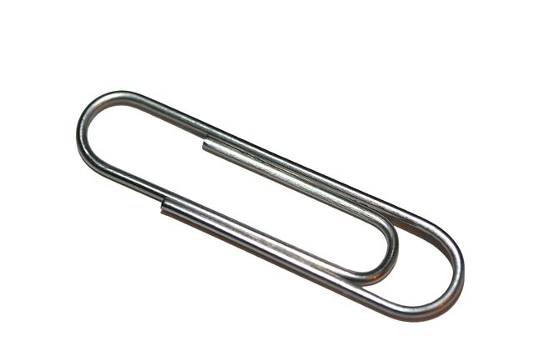
Limitations of P4₁₆
The core P4 language is very small
Highly portable among many targets
But very limited in expressivity
Accelerators can provide additional functionality
May not be portable between different targets
Under construction: library of standard accelerators

Slide 43


What is missing
Floating point
Pointers, references
Data structures, recursive data types
Dynamic memory management
Loops, iterators (except the parser state-machine)
Recursion
Threads
=> Constant work/byte of header

Slide 44

What cannot be done in (pure) P4
Multicast or broadcast
Queueing, scheduling, multiplexing
Payload processing: e.g., encryption
Packet trailers
Persistent state across packets
Communication to control-plane
Inter-packet operations (fragmentation and reassembly)
Packet generation
Timers

Slide 45

How are these done?
Multicast, broadcast, queueing, scheduling, multiplexing
By target device, controlled by P4 metadata
Persistent state across packets (e.g. per-flow state)
External objects: registers, counters, meters
Communication to control-plane
External objects: learning providers
Packet generation
Control-plane, or external objects
Reassembly, trailers:
Not currently done

Slide 46

P4 is not…
Active networking: a way for packets to inject new code
Programming the control plane: that is Software-Defined Networking
A tool for third parties to program the network
A language for:
distributed computations
network middleboxes (NFV)
network operating systems

Slide 47

Why use P4?
It is a language: you can specify the data-plane precisely
Expressive: express many packet-forwarding policies
High-level, type-safe: compiler-managed abstract resources
Software: treat network devices like software
Killer app: network monitoring

Slide 48
Creating a Programming Language Interface in a place where there wasn’t one.
UPLOAD
Control plane
The P4 Programming- Language Interface
Data plane

